Slide 1
Chapter 6
Differential Calculus
The two basic forms of calculus are differential calculus and integral calculus. This chapter will be devoted to the former and Chapter 7 will be devoted to the latter. Finally, Chapter 8 will be devoted to a study of how MATLAB can be used for calculus operations.

Slide 2
Differentiation and the Derivative
The study of calculus usually begins with the basic definition of a derivative. A derivative is obtained through the process of differentiation, and the study of all forms of differentiation is collectively referred to as differential calculus.If we begin with a function and determine its derivative, we arrive at a new function called the first derivative. If we differentiate the first derivative, we arrive at a new function called the second derivative, and so on.

Slide 3
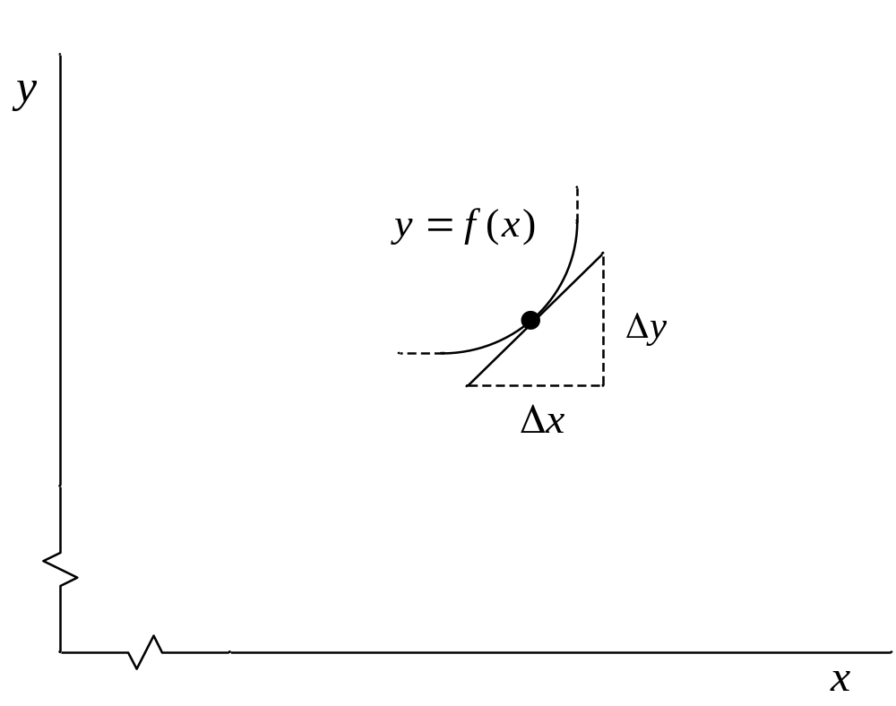
The derivative of a function is the slope at a given point.

Slide 4
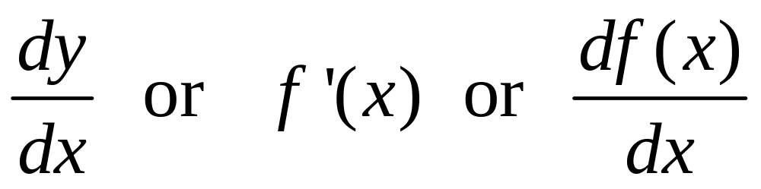
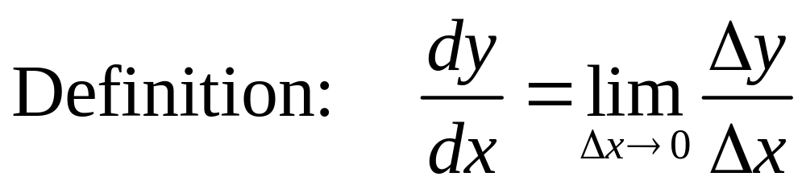
Various Symbols for the Derivative

Slide 5
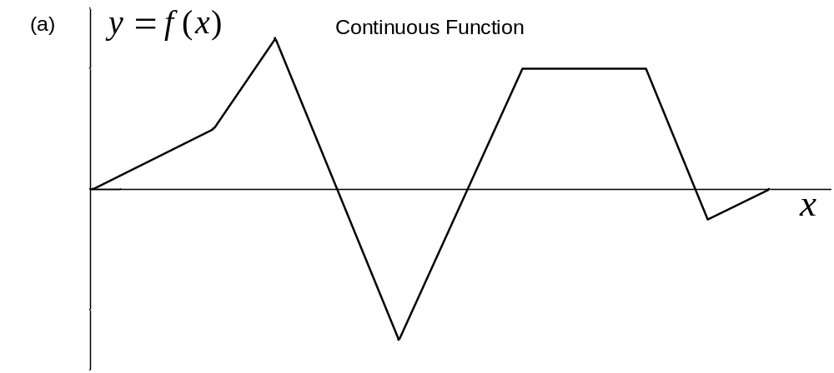
Figure 6-2(a). Piecewise Linear Function (Continuous).

Slide 6
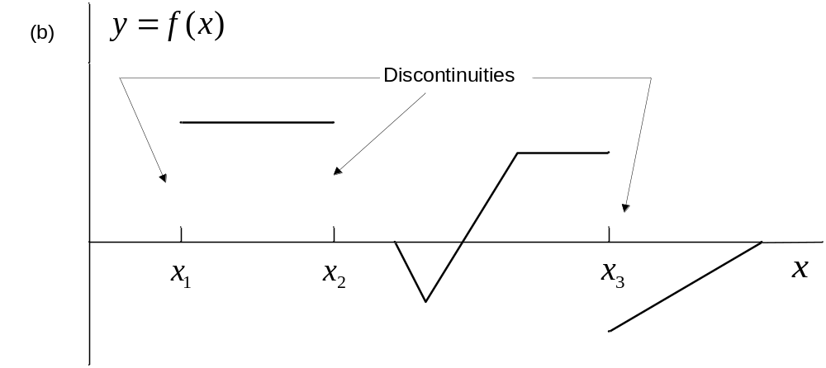
Figure 6-2(b). Piecewise Linear Function (Finite Discontinuities).

Slide 7
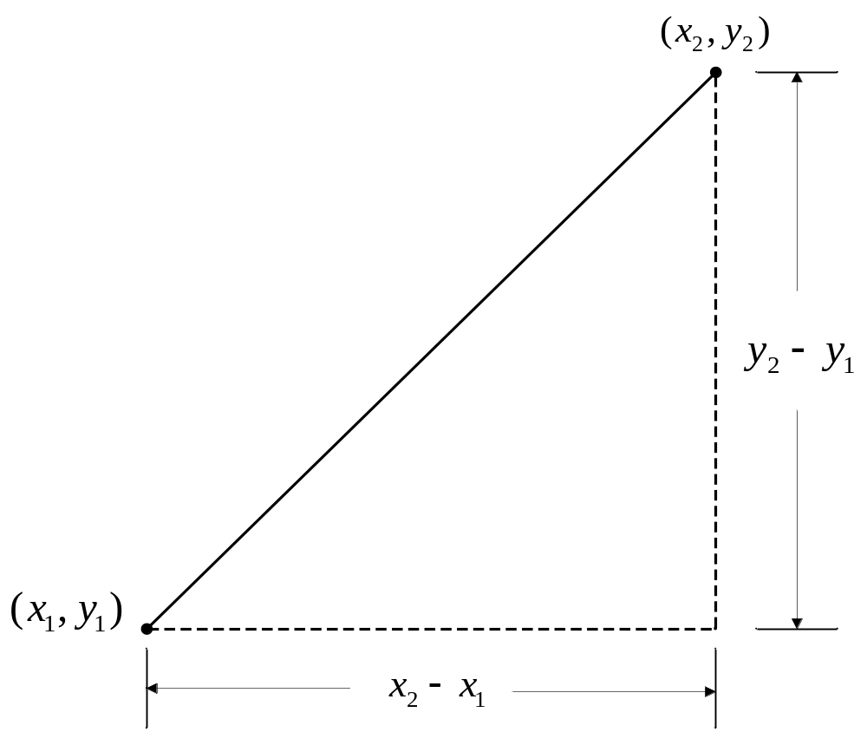
Piecewise Linear Segment

Slide 8
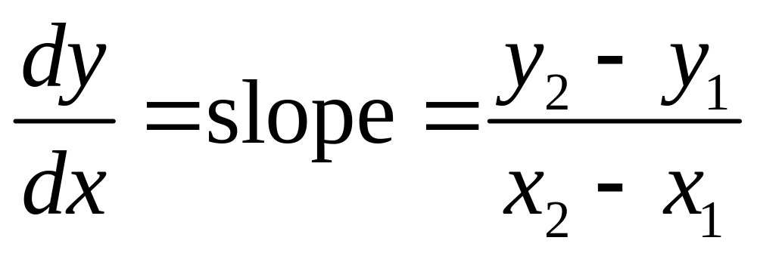
Slope of a Piecewise Linear Segment

Slide 9
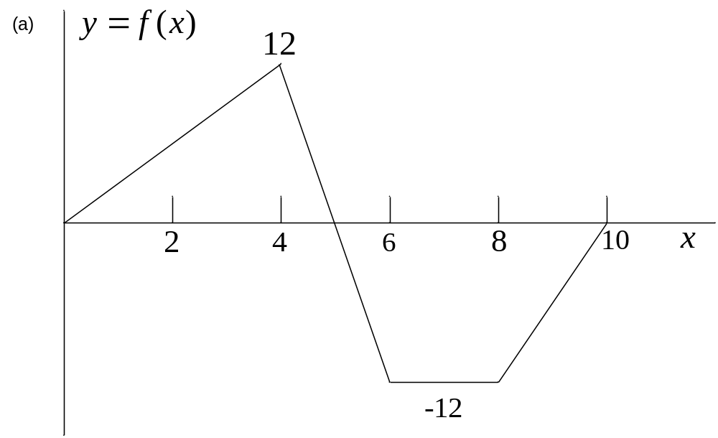
Example 6-1. Plot the first derivative of the function shown below.

Slide 10
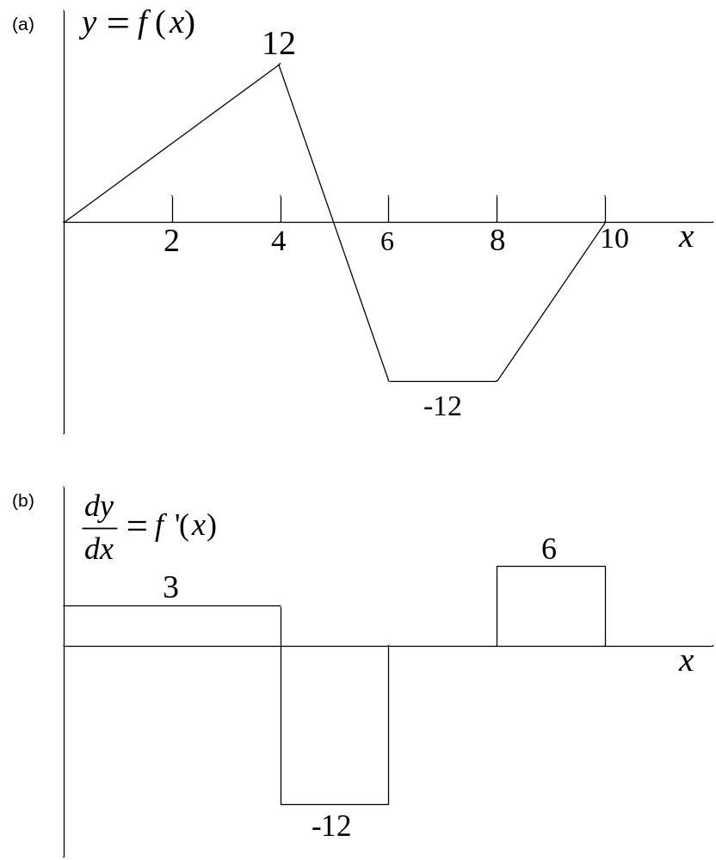

Slide 11
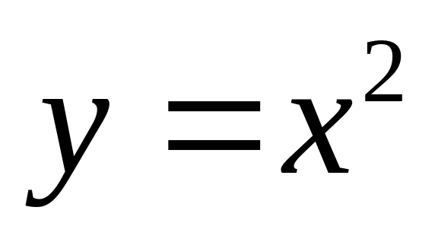
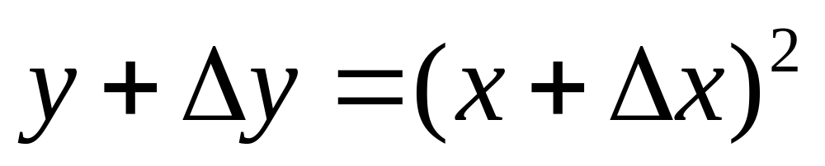
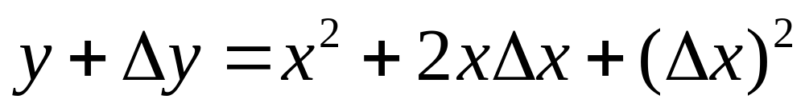
Development of a Simple Derivative

Slide 12
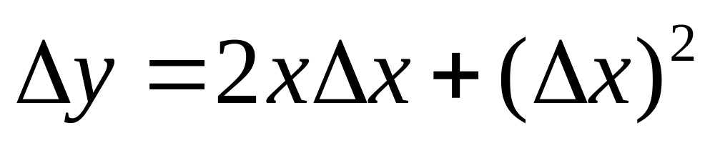
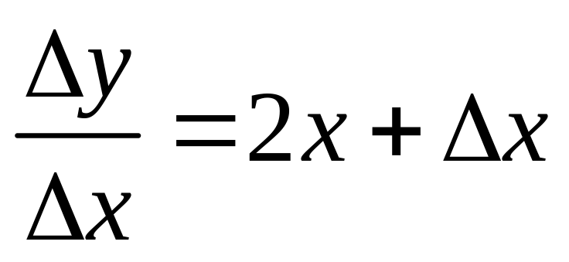
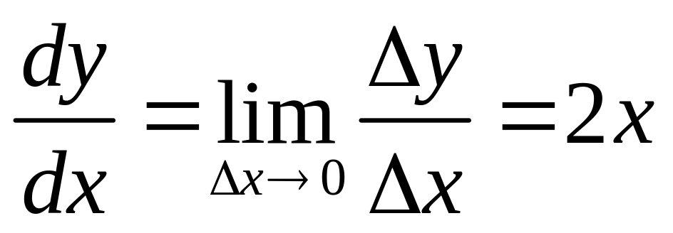
Development of a Simple Derivative
Continuation

Slide 13
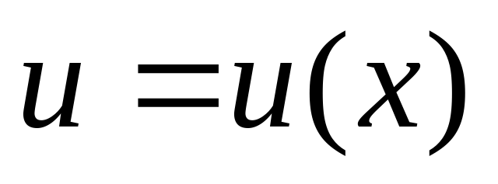
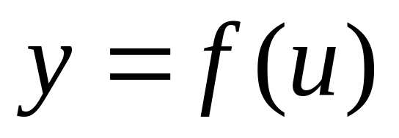
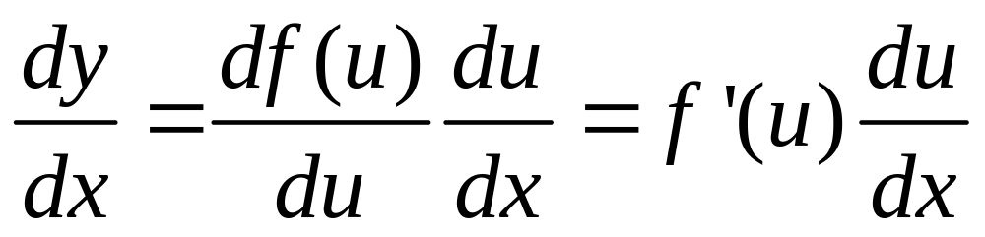
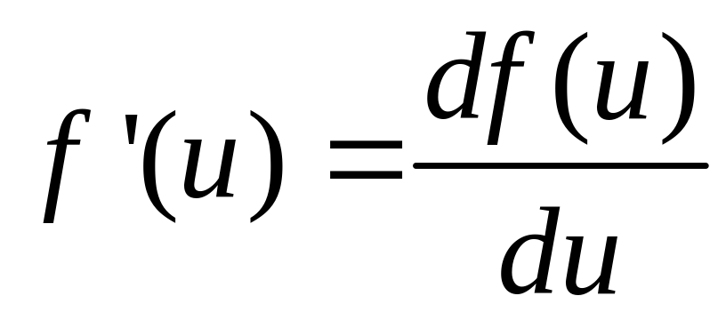
Chain Rule
where

Slide 14
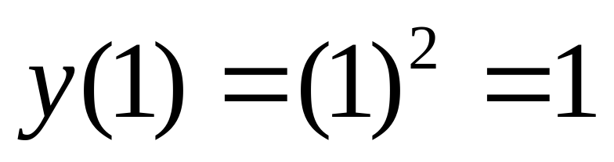
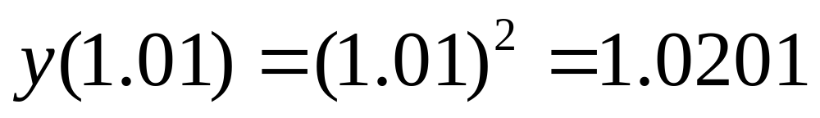
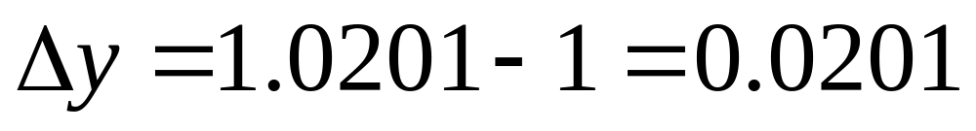
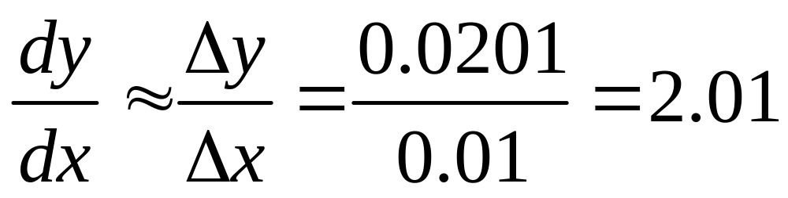
Example 6-2. Approximate the derivative of y=x² at x=1 by forming small changes.

Slide 15
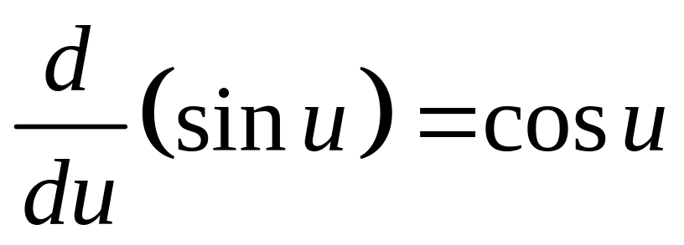
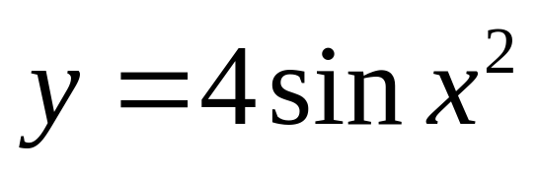
Example 6-3. The derivative of sin u with respect to u is given below.
Use the chain rule to find the derivative with respect to x of

Slide 16
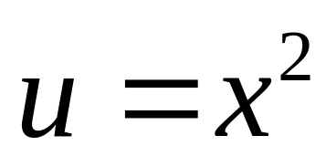
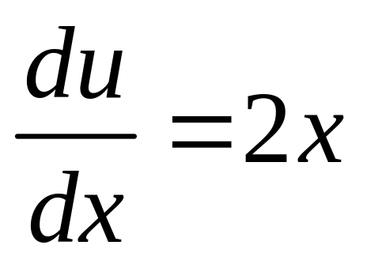
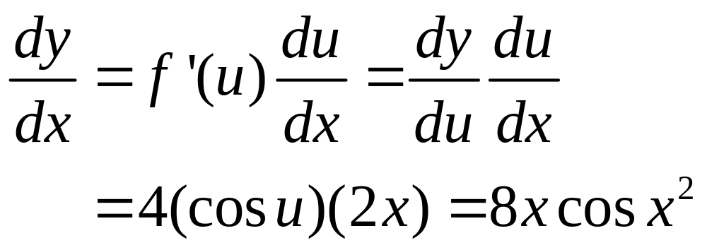
Example 6-3. Continuation.

Slide 17
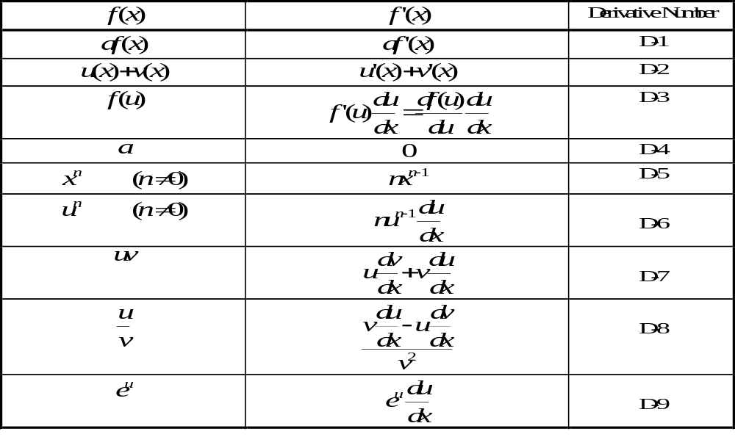
Table 6-1. Derivatives

Slide 18
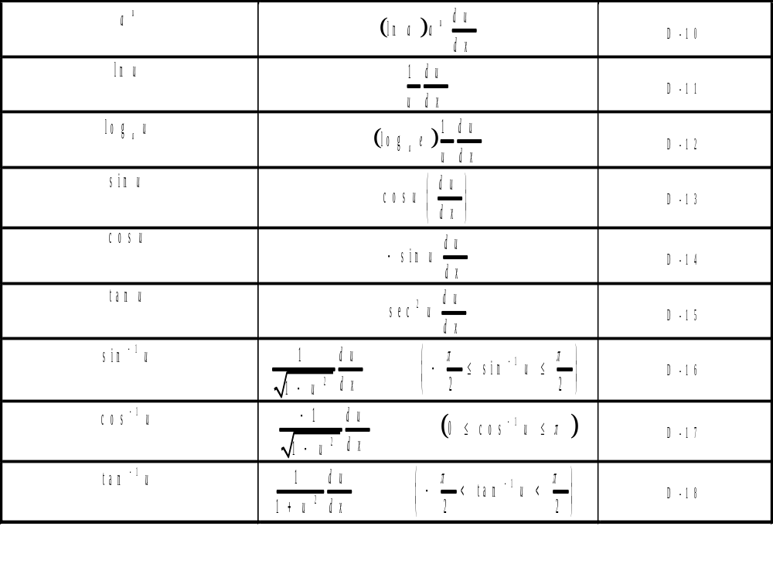
Table 6-1. Derivatives (Continued)

Slide 19
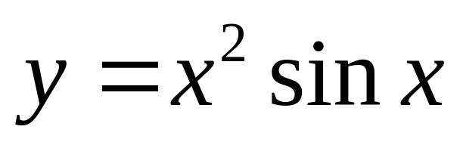
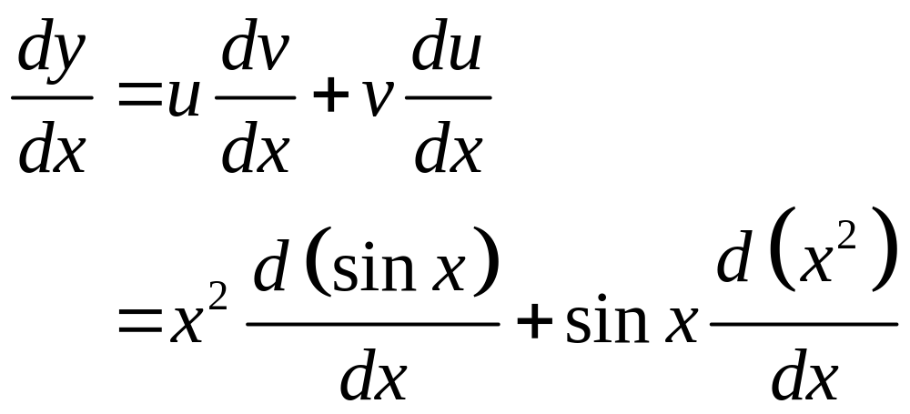
Example 6-4. Determine dy/dx for the function shown below.

Slide 20
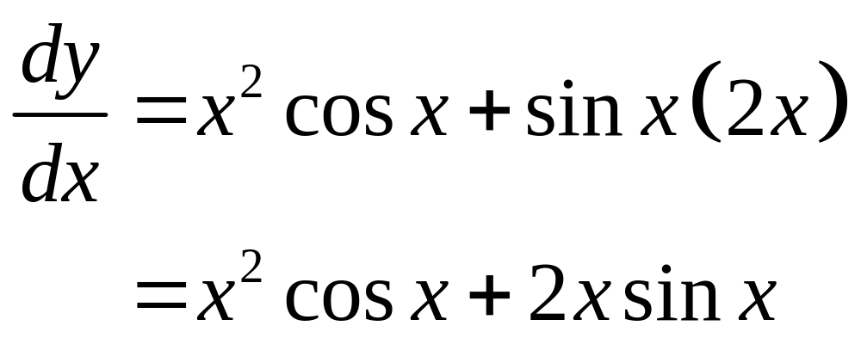
Example 6-4. Continuation.

Slide 21
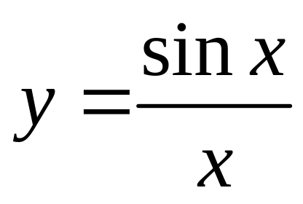
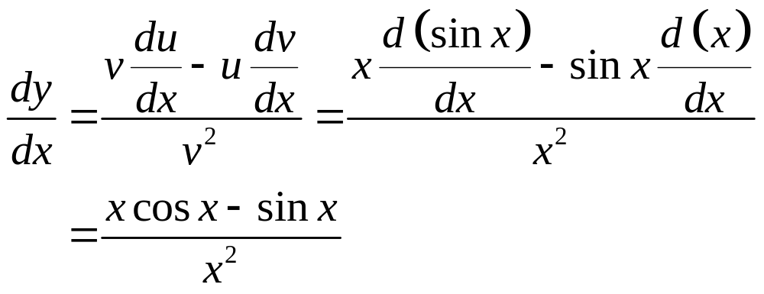
Example 6-5. Determine dy/dx for the function shown below.

Slide 22
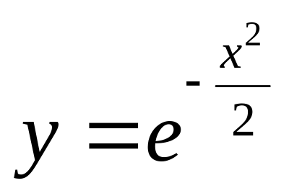
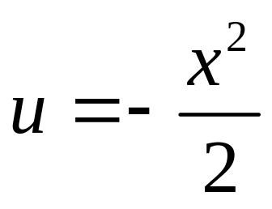
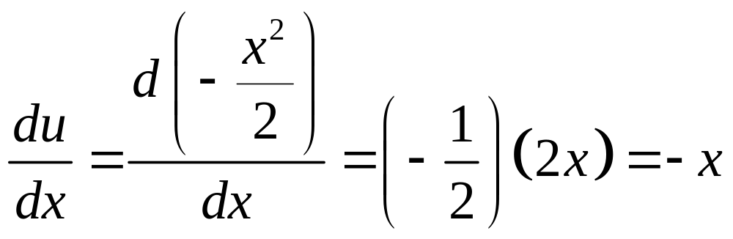
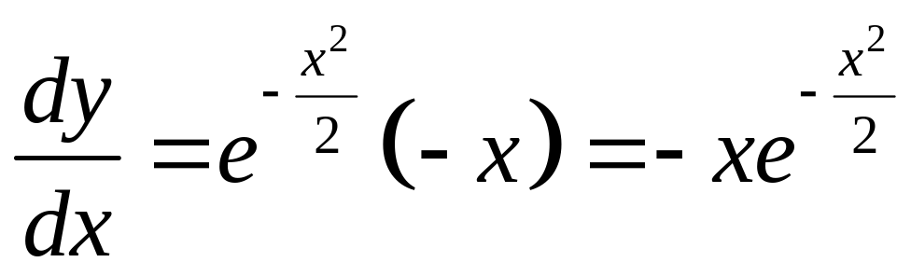
Example 6-6. Determine dy/dx for the function shown below.

Slide 23
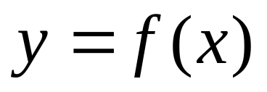
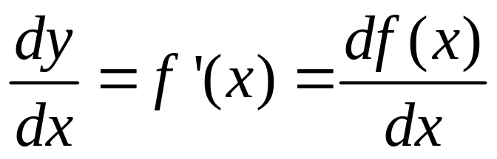
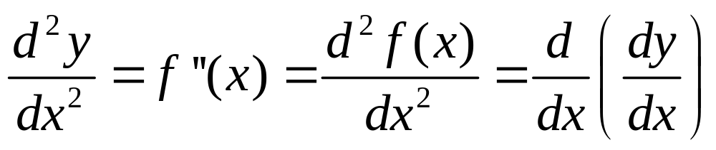
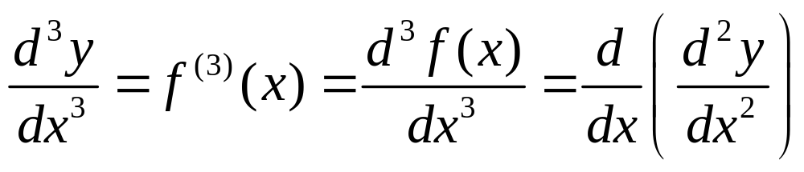
Higher-Order Derivatives

Slide 24
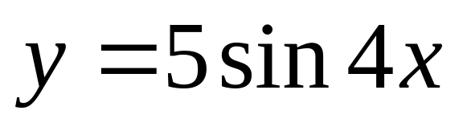
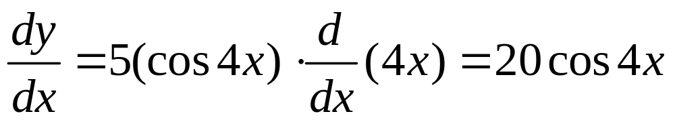
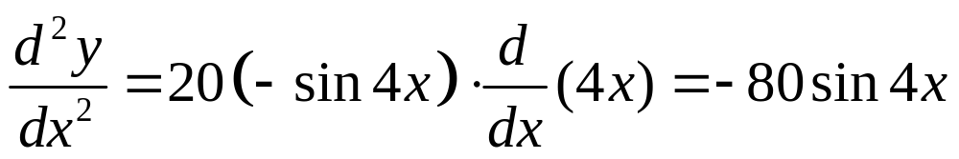
Example 6-7. Determine the 2nd derivative with respect to x of the function below.

Slide 25
Applications: Maxima and Minima
1. Determine the derivative.
2. Set the derivative to 0 and solve for values that satisfy the equation.
3. Determine the second derivative.
  (a) If second derivative > 0, point is a minimum.
  (b) If second derivative < 0, point is a maximum.

Slide 26
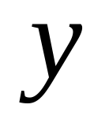
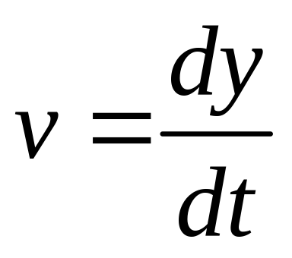
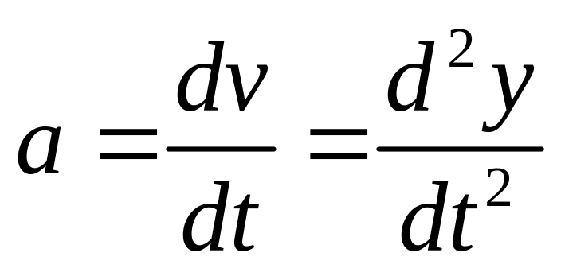
Displacement, Velocity, and Acceleration
Displacement
Velocity
Acceleration

Slide 27
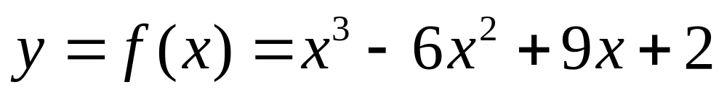



Example 6-8. Determine local maxima or minima of function below.

Slide 28


Example 6-8. Continuation.
For x = 1, f”(1) = -6. Point is a maximum and
y_{max}= 6.
For x = 3, f”(3) = 6. Point is a minimum and
y_{min} = 2.

